Slide 1

Movie Performance Trend Analysis: Identifying Types of Movies Best for the Box Office
By The Data Monsters

Slide 2
Overview
The main goal for this project is to identify the types of movies that usually do best at the box office. The head of our company's new studio aims to gain more information to help decide what type of films the company can start creating.
By analyzing the current movie trends and identifying the high performing genres, this analysis will provide relevant insights for the next best actions.

Slide 3

Problem Statement
Understanding Movie Trends
Context: Our company has decided to venture into creating original video content, aiming to have the movies do the best at the box office.
Problem: Limited to no knowledge about creating movies.
Key Question: What type of movies do the best at the Box Office?

Slide 4
Goal
Main Objective
To identify the top-performing film genres in terms of profit by analyzing which film genres (action, drama, comedy, animation, etc.) are performing best at the box office and identifying the highest performing genre over the last decade.
Secondary objectives
Timing of Release: To assess seasonal effects on movie release and performance, identifying the most lucrative months for specific types of films.
Director Influence: To evaluate directors and their influence on movies' box office success.
Critic Rating: To analyze the effect of critic ratings on box office success.
Studios: To identify the highest performing studios (Warner Bros, Sony, Universal, etc.).

Slide 5

Data Overview
Data Used for Analysis
Dataset source: The data was sourced from different sources i.e. (Box Office Mojo, IMDB, Rotten Tomatoes, TheMovieDB, The Numbers). Click Here to get the data source zip file.
Key Features
Box Office Mojo: This dataset includes detailed information on movie titles, genres, box office revenues, release dates, and production budgets.
IMDb: Provides comprehensive data on movie ratings, cast, crew, and user reviews, useful for understanding audience reception.
Rotten Tomatoes: Aggregated critic and audience scores that offer insights into how reviews impact movie success.
The Numbers: A source for financial performance metrics, including production costs and box office earnings, helpful in analyzing budget-to-revenue ratios.

Slide 6
Data Overview
Key Features continuation
Box Office Data: Historical data on movie releases, including genres, box office revenues, release dates, and production budgets.
Review Scores: Aggregated critic and audience scores from platforms like Rotten Tomatoes, IMDb.
Competitor Analysis: Data on top-performing movies from competitors, including genre, budget, marketing strategies, and box office performance i.e. Bom. Movies
Streaming Trends: Data on movie viewership trends on streaming platforms to understand shifts in audience behavior.

Slide 7

Analysis Steps
Our Analytical approach
In general, a couple of python libraries(pandas, seaborn, numpy, matplotlib)was used for the data preparation, analysis and visualization part of this project. Tablaeu was also used to create more interactive visualizations. Xgb python library was used to build our predictive model.
Data Exploration
- Distribution of movies over time, genre, popularity, directors and
studios.
- Trends of movie, genre popularity over time.

Slide 8

Analytical Steps
Continuation
2. Visualization
- Line plots for popularity or profits over time.
- Bar plots for profits, popularity vs directors, genres and studios
- Heat map for correlations between the metrics
3. Modeling
- A profit prediction model
4. Insights
- Focusing on profitability and popularity of movies for the box office.

Slide 9

Potential Challenges
Data Availability: There is limited access to data from competitors or other streaming platforms.
Data Integration: We are combining data from various sources (e.g., box office mojo, the numbers ,IMDB) to provide a comprehensive analysis.
Missing Values: There are large datasets with a lot of missing values.

Slide 10
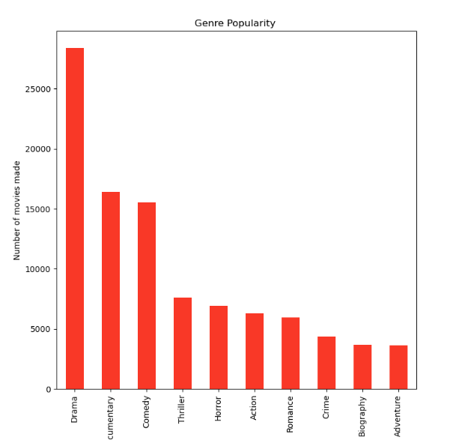
Observations
Key Insights
From this we can conclude the top 10 genres are:
Drama with 28394 movies
Documentary with 16423 movies
Comedy with 15514 movies
Thriller with 7583 movies
Horror with 6917 movies
6. Action with 6297 movies
7. Romance with 5976 movies
8. Crime with 4338 movies
9. Biography with 3693 movies
10. Adventure with 3621 movies
These are the most preferred movies genres.

Slide 11
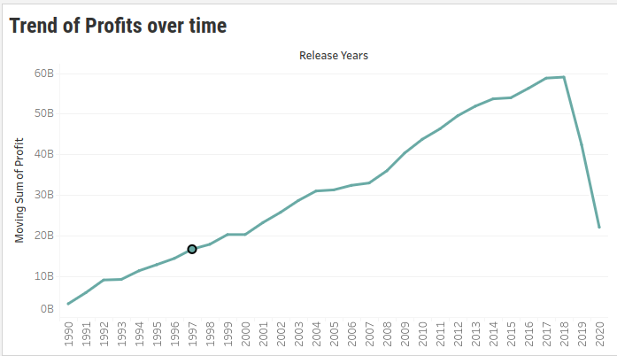
Observations
Key Insights
Profits increase gradually over the years. The drop in the year 2020 and 2019 was maybe due to covid-19.

Slide 12
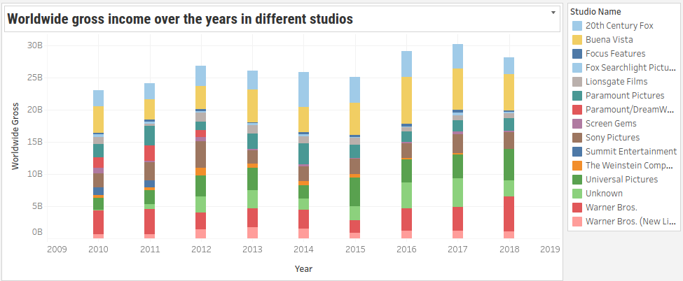
Observations
Key Insights
The gross income in different studios varies but we can conclude that Buena Vista(Walt Disney), Waner Bros and Universal Pictures studios generate the most worldwide income annually.

Slide 13
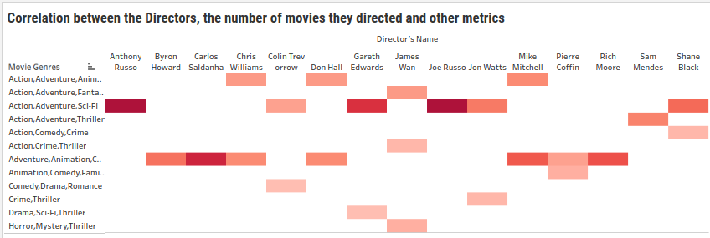
Observation
Key Insights
From this we can observe that the top 10 directors by average profit earned are:
1. Anthony Russo with $1,205,154,000 average profit
2. Joe Russo with $1,205,154,000 average profit
3. Colin Trevorrow with $1,195,491,000 average profit
4. Adam Green with $1,122,470,000 average profit
5. Chris Buck with $1,122,470,000 average profit
6. Kyle Balda with $1,001,931,000 average profit
7. Anna Boden with $948,061,600 average profit
8. Ryan Fleck with $948,061,600 average profit
9. James Wan with $843,016,808 average profit
10. Pierre Coffin with $778,452,400 average profit
There is overwhelming evidence to conclude that profits significantly differ among directors therefore directors have a significant impact on a film making profit.

Slide 14

Conclusion
Based on our analysis, we have successfully built a predictive model that is 86.77% accurate in forecasting Profit using key features such as Director Name, Genre, and Critic Rating. This high level of accuracy indicates that these factors play a significant role in determining a film's profitability, and our model can be a valuable tool for understanding and predicting the financial success of films in the industry.

Slide 15
Recommendations
Focus on High-Performing Directors: Given the significant impact of director name on profit, studios should prioritize collaborating with successful directors who have a proven track record of creating profitable films. Directors like Anthony Russo and Joe Russo, who are at the top of the list, should be considered for future high-budget productions.
Invest in Profitable Genres: The model highlights certain genres, such as Sci-Fi and Adventure, which are associated with higher profitability. Studios should consider focusing more on these genres, as they tend to generate higher returns at the box office. Exploring emerging trends within these genres or creating sequels and franchises could also enhance profitability.

Slide 16
Recommendations
Enhance Film Quality to Improve Critic Ratings: Since Critic Ratings have a noticeable effect on profitability, studios should focus on improving the quality of films in ways that appeal to critics. This could involve refining the script, investing in high-quality production, or assembling a strong cast. A positive critical reception not only attracts wider audiences but also improves the overall perception of the film, which can lead to increased box-office revenue.
Tailor Marketing Strategies Based on Predictive Insights: With the model's ability to predict profit based on key features, studios can tailor their marketing strategies to emphasize the strengths of a film. For example, if a film features a top-tier director or belongs to a high-performing genre, marketing campaigns can be designed to capitalize on these elements to generate more buzz and attract a larger audience.
Optimize Resource Allocation: The model provides valuable insights into the relationship between various features (e.g., director, genre, critic rating) and profitability. Studios can use this information to allocate resources more effectively, ensuring that higher budgets are directed towards projects with higher potential for success, while lower budgets can be invested in projects with potentially more niche audiences.

Slide 17

Summary
In summary, our analysis has yielded key insights and actionable strategies for improving film profitability:
Predictive Model Success:
- We have developed an 86.77% accurate predictive model for forecasting movie profits, leveraging factors such as director, genre, and critic ratings.
2. Key Drivers of Profitability:
- Directors: High-performing directors significantly impact profitability, with directors like Anthony Russo and Joe Russo leading the pack.
- Genres: Sci-Fi and Adventure genres consistently generate higher returns, presenting a lucrative focus area for studios.
- Critic Ratings: Positive critical reception boosts profitability, emphasizing the importance of film quality.

Slide 18
Summary
3. Strategic Recommendations:
- Prioritize collaboration with proven directors for high-budget productions.
Invest in profitable genres, including Sci-Fi and Adventure, while exploring franchise opportunities.
- Focus on quality improvements to enhance critic ratings and audience appeal.
- Leverage predictive insights to tailor marketing strategies and optimize resource allocation.
These findings and recommendations provide a robust framework for decision-making, enabling studios to maximize returns and achieve sustained success in the film industry

Slide 19
Thank You for your time
For further queries please feel free to contact us at:
amani.mkaya@student.moringaschool.com
rodgers.ndemo@student.moringaschool.com
adnanahmedmohamund1@gmail.com
kiprono.bett@student.moringaschool.com
beverlyne.langat@student.moringaschool.com
betsy.gitije@student.moringaschool.com

Slide 20

Q & A

Slide 21

The End

